Slide 1
CSE325
Project Presentation
(Group – 01)

Slide 2
Group Members
Iftakhar Ahmed Mahin

Slide 3
Project Name
The Sandwich Problem

Slide 4
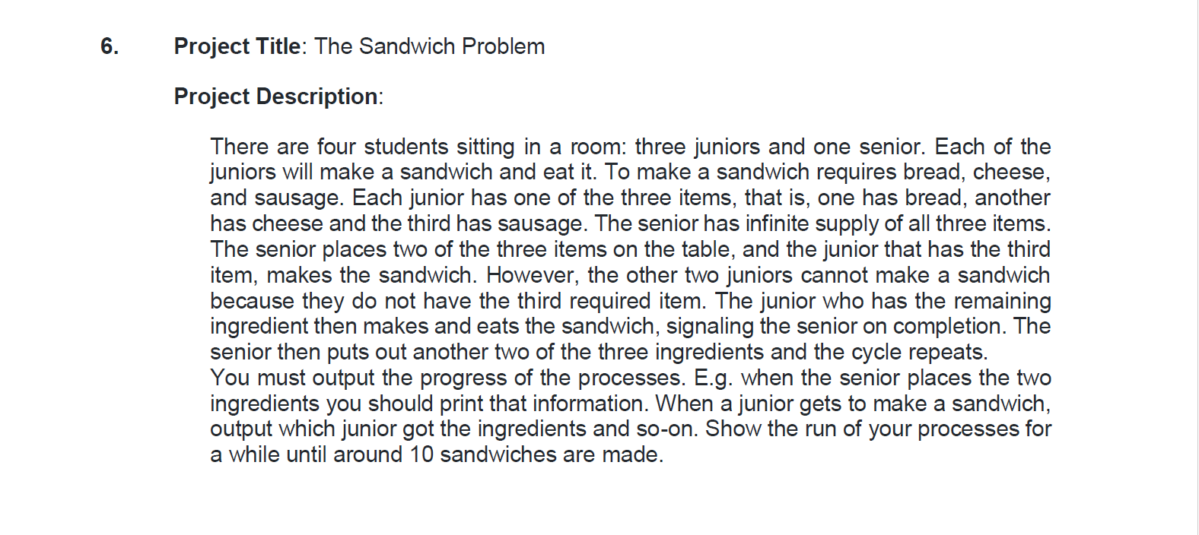

Slide 5
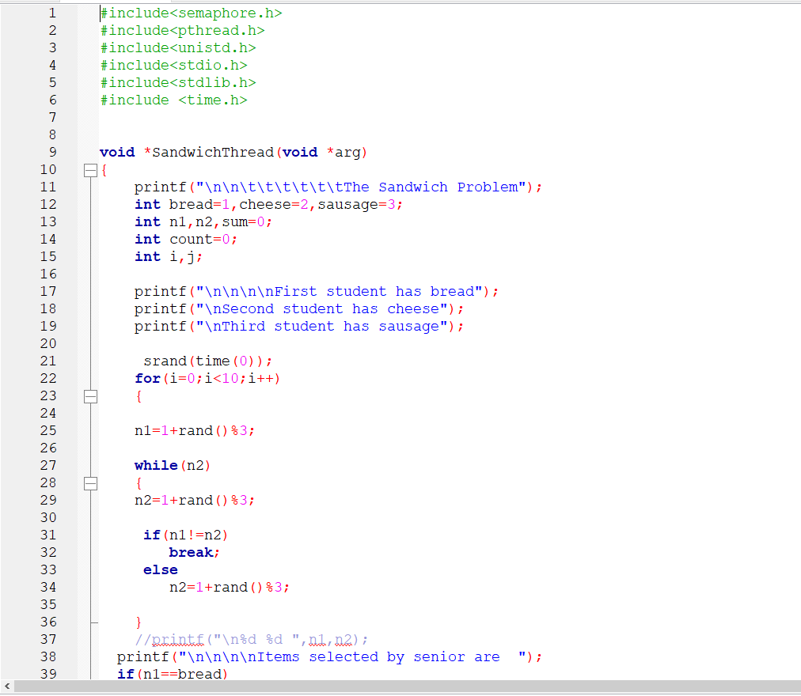
Code

Slide 6
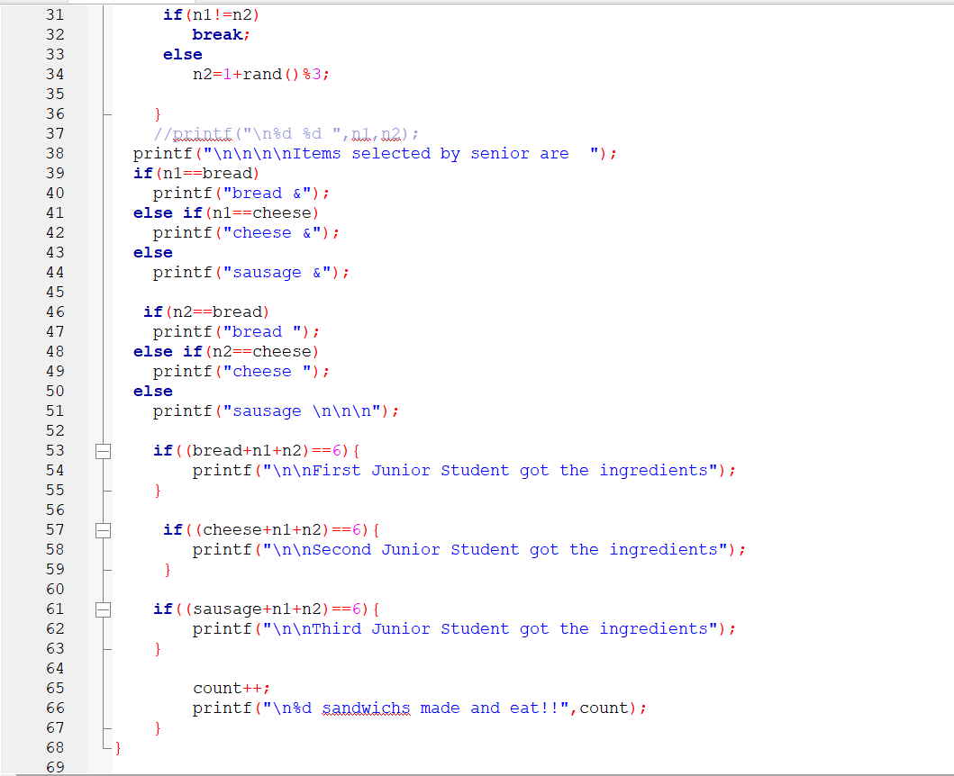

Slide 7
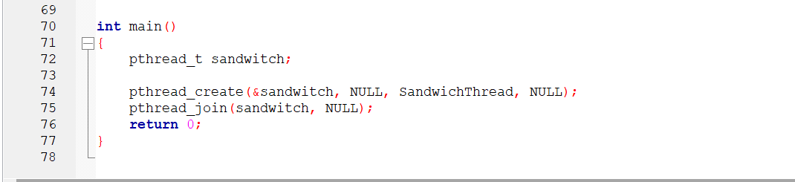

Slide 8
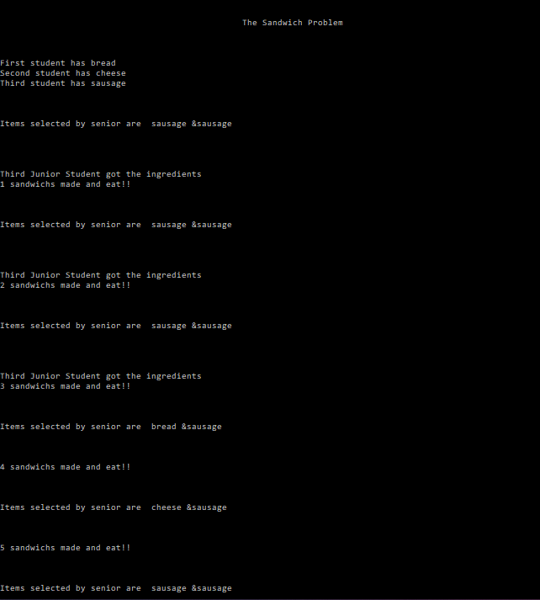
Execution

Slide 9
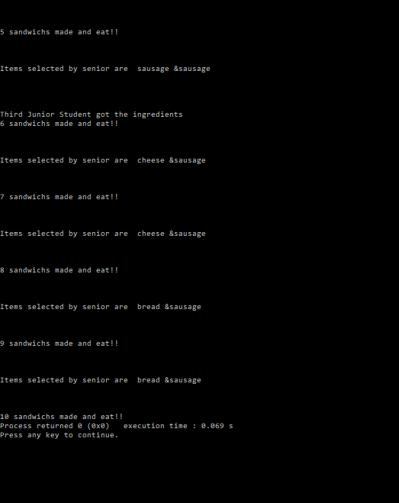

Slide 10
Thank You

